Slide 1

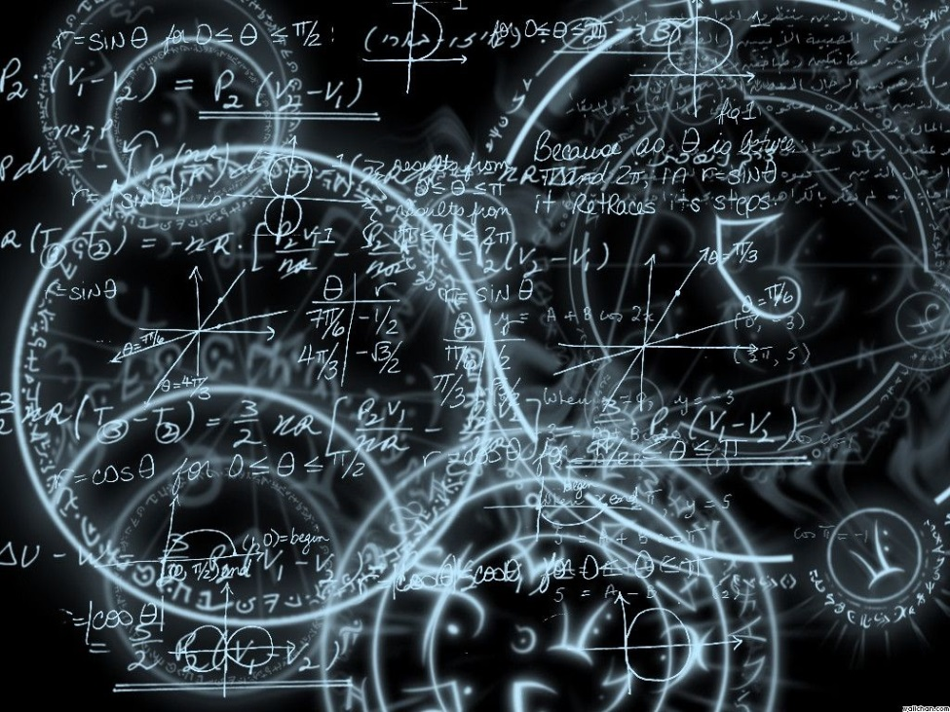
Azərbaycan Dövlət Neft və Sənaye Universiteti
Calculus
Single Variable

Slide 2
Integration Techniques:
Basic Integration Rules

Slide 3
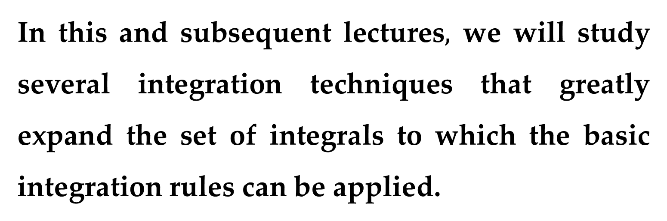
In this and subsequent lectures$,$ we will study several integration techniques that greatly expand the set of integrals to which the basic integration rules can be applied.
A major step in solving any integration problem is recognizing which basic integration rule to use.

Slide 4
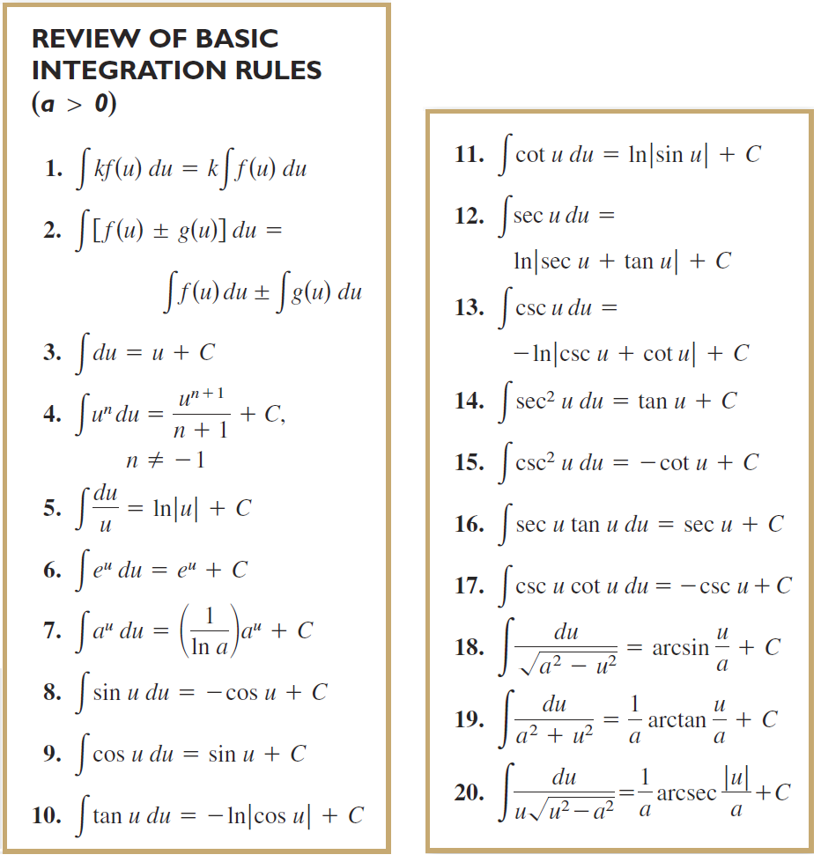

Slide 5
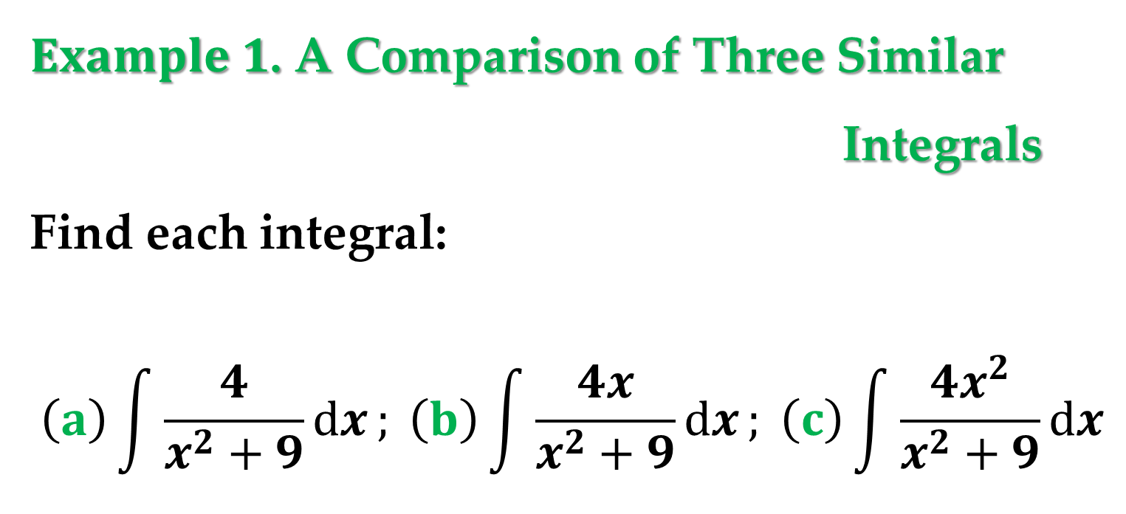
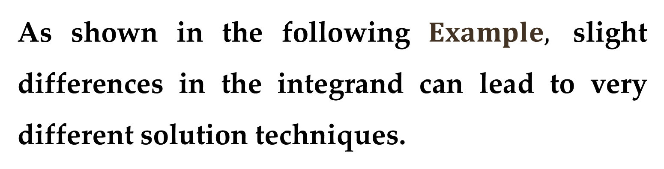
As shown in the following $Example,$ slight differences in the integrand can lead to very different solution techniques.
$Example 1$. A Comparison of Three Similar
Integrals
Find each integral:
$$\left(a\right)\int{\frac{4}{x^{2}+9}dx}; \left(b\right)\int{\frac{4x}{x^{2}+9}dx}; \left(c\right)\int{\frac{4x^{2}}{x^{2}+9}dx}$$

Slide 6

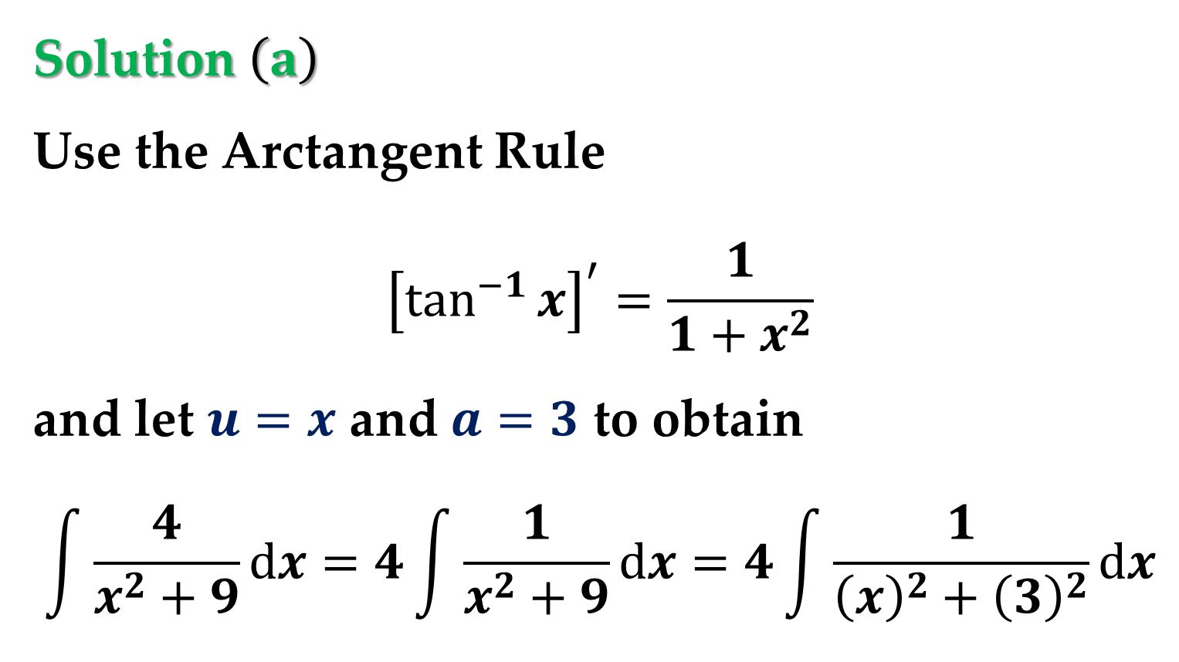
Solution $\left(a\right)$
Use the Arctangent Rule
$${\left[\tan^{−1}{x}\right]}^{′}=\frac{1}{1+x^{2}}$$
and let $u=x$ and $a=3$ to obtain
$$\int{\frac{4}{x^{2}+9}dx}=4\int{\frac{1}{x^{2}+9}dx}=4\int{\frac{1}{{\left(x\right)}^{2}+{\left(3\right)}^{2}}dx}$$
$$…=4\left(\frac{1}{3}arctan\frac{x}{3}\right)+C$$

Slide 7
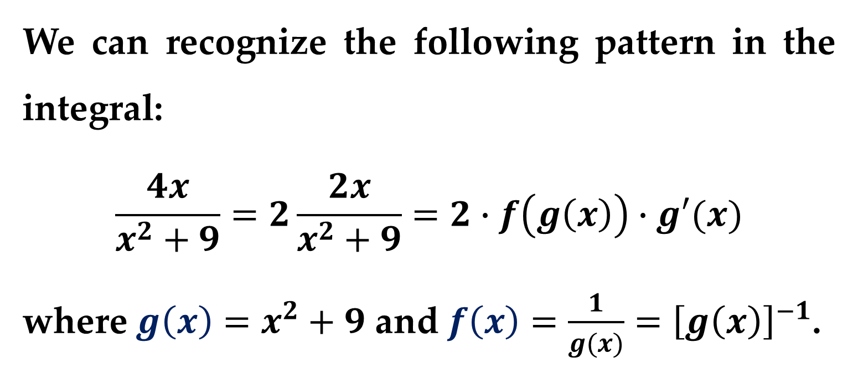
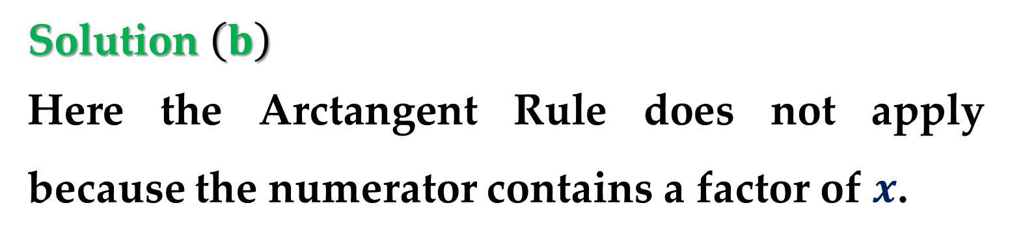
Solution $\left(b\right)$
Here the Arctangent Rule does not apply because the numerator contains a factor of $x$.
We can recognize the following pattern in the integral:
$$\frac{4x}{x^{2}+9}=2\frac{2x}{x^{2}+9}=2∙f\left(g\left(x\right)\right)∙g′(x)$$
where $g\left(x\right)=x^{2}+9$ and $f\left(x\right)=\frac{1}{g(x)}={\left[g\left(x\right)\right]}^{−1}$.

Slide 8
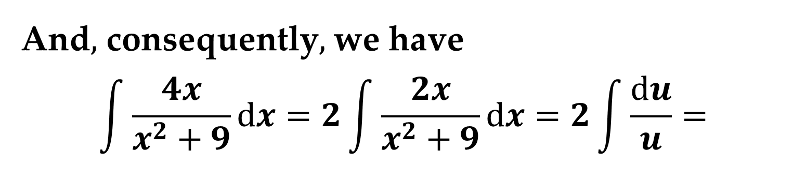
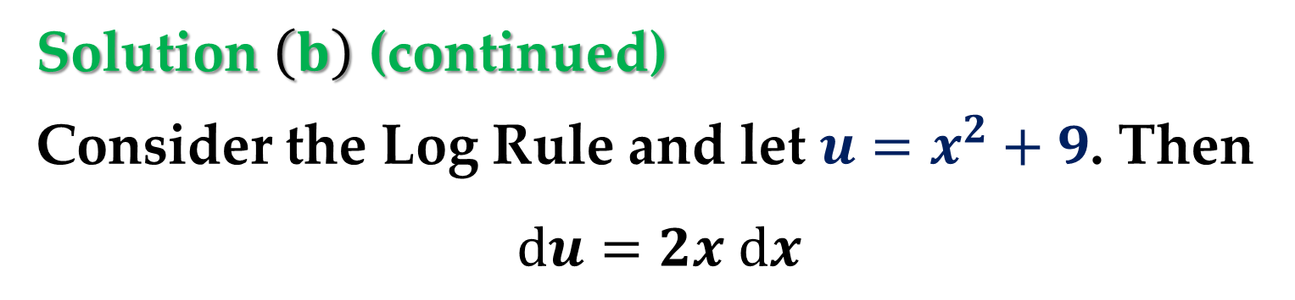
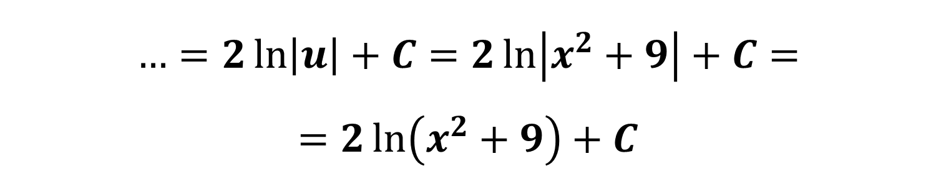
Solution $\left(b\right)$ (continued)
Consider the Log Rule and let $u=x^{2}+9$. Then
$$du=2x dx$$
And$,$ consequently$,$ we have
$$\int{\frac{4x}{x^{2}+9}dx}=2\int{\frac{2x}{x^{2}+9}dx}=2\int{\frac{du}{u}}=$$
$$…=2\ln\left|u\right|+C=2\ln\left|x^{2}+9\right|+C=$$
$$=2\ln\left(x^{2}+9\right)+C$$

Slide 9
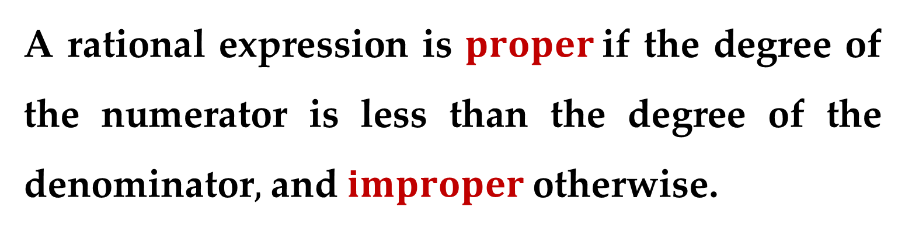
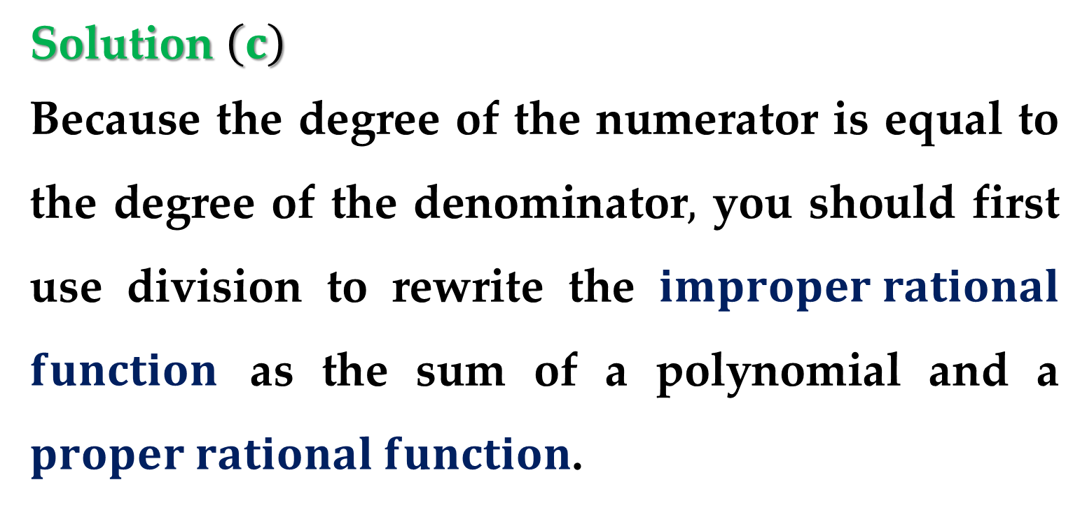
Solution $\left(c\right)$
Because the degree of the numerator is equal to the degree of the denominator$,$ you should first use division to rewrite the $improper rational$ $function$ as the sum of a polynomial and a $proper rational function$.
A rational expression is $proper$if the degree of the numerator is less than the degree of the denominator$,$ and $improper$otherwise.

Slide 10

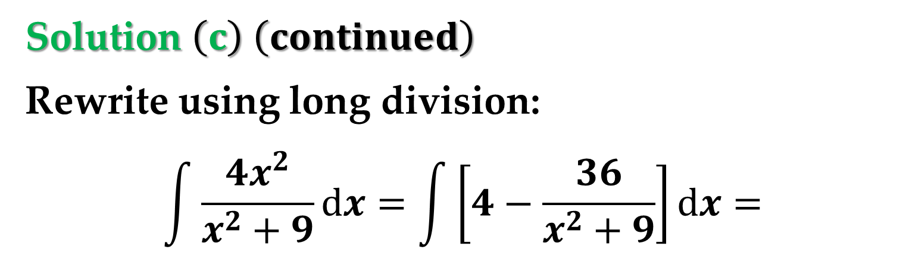

Solution $\left(c\right) \left(continued\right)$
Rewrite using long division:
$$\int{\frac{4x^{2}}{x^{2}+9}dx}=\int{\left[4−\frac{36}{x^{2}+9}\right]dx}=$$
$$…=\int{4 dx}−36\int{\frac{dx}{x^{2}+9}}$$
$$…=4x−36\left(\frac{1}{3}arctan\frac{x}{3}\right)+C$$

Slide 11
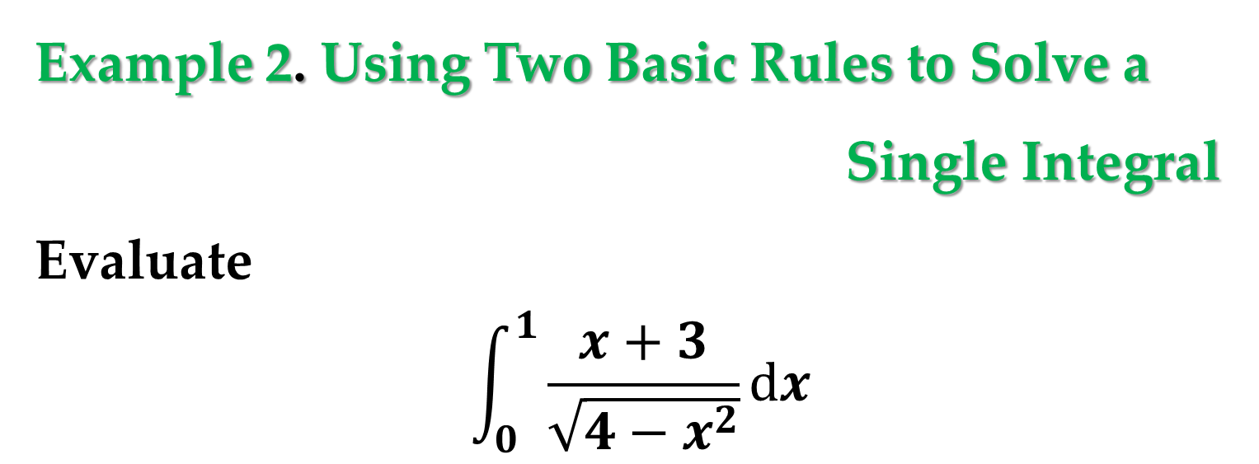
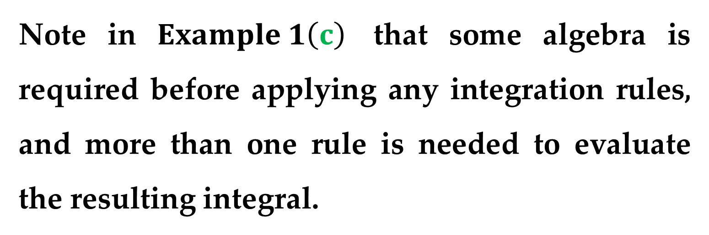
Note in $Example 1\left(c\right)$ that some algebra is required before applying any integration rules, and more than one rule is needed to evaluate the resulting integral.
Example 2. Using Two Basic Rules to Solve a
Single Integral
Evaluate
$$\int_{0}^{1}{\frac{x+3}{\sqrt{4−x^{2}}}dx}$$

Slide 12
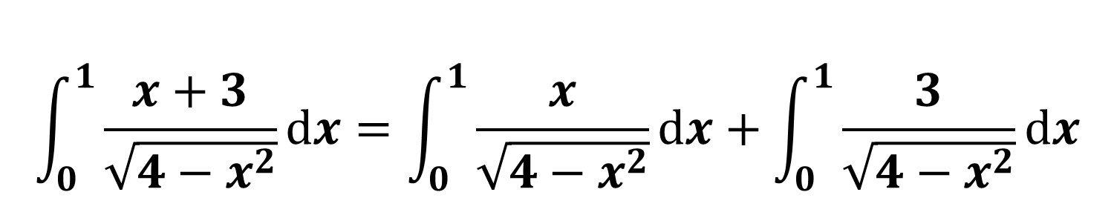
Solution
Begin by writing the integral as the sum of two integrals.
Then apply the Power Rule and the Arcsine Rule.
$$\int_{0}^{1}{\frac{x+3}{\sqrt{4−x^{2}}}dx}=\int_{0}^{1}{\frac{x}{\sqrt{4−x^{2}}}dx}+\int_{0}^{1}{\frac{3}{\sqrt{4−x^{2}}}dx}$$

Slide 13

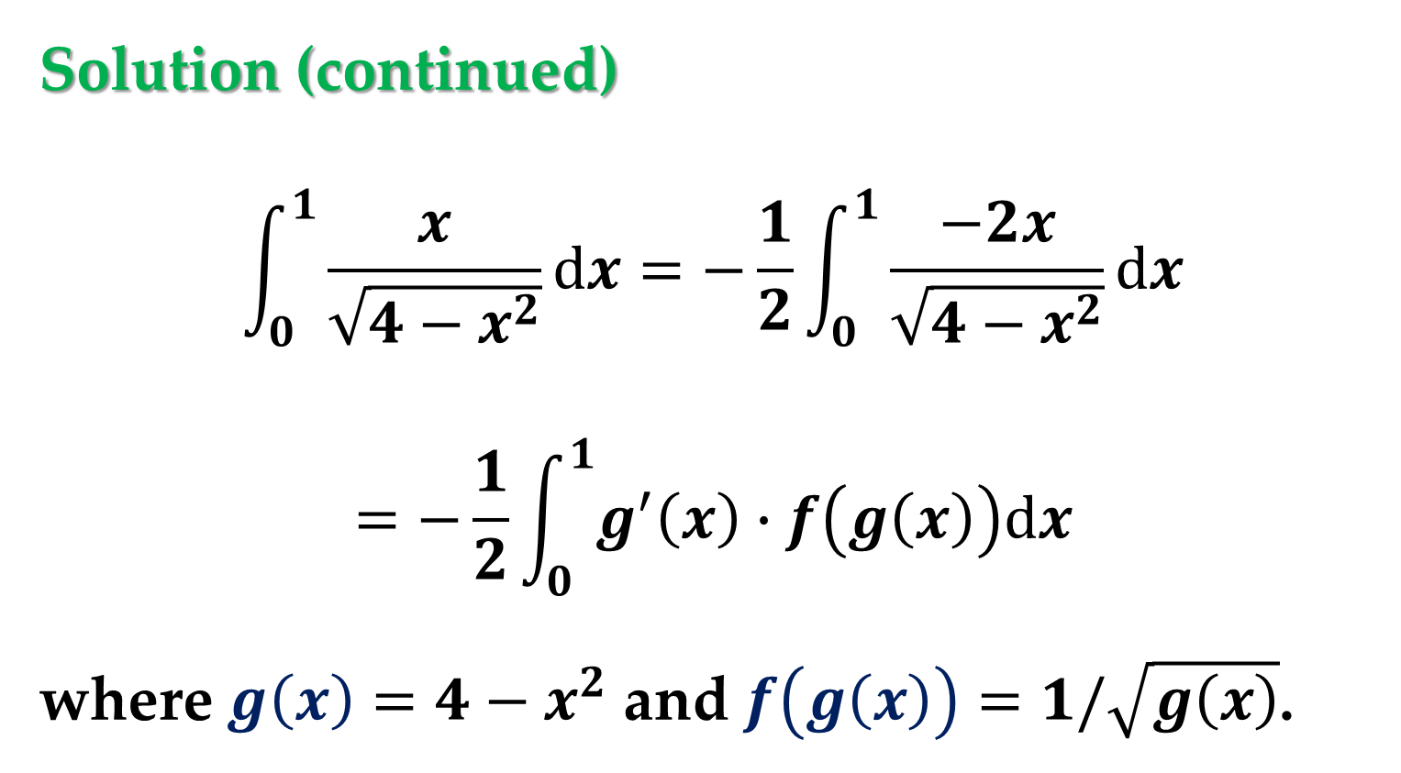
Solution (continued)
$$\int_{0}^{1}{\frac{x}{\sqrt{4−x^{2}}}dx}=−\frac{1}{2}\int_{0}^{1}{\frac{−2x}{\sqrt{4−x^{2}}}dx}$$
$$=−\frac{1}{2}\int_{0}^{1}{g^{′}\left(x\right)∙f\left(g\left(x\right)\right)dx}$$
where $g\left(x\right)=4−x^{2}$ and $f\left(g\left(x\right)\right)=1/\sqrt{g\left(x\right)}$.
Evaluating the antiderivative of $u^{−1/2},$ we get
$$2 u^{1/2}$$

Slide 14
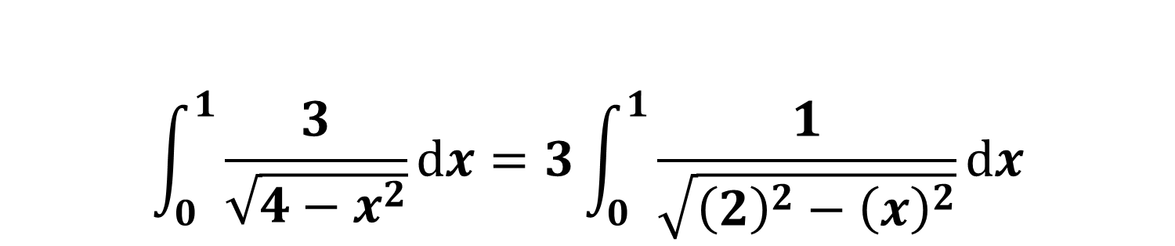
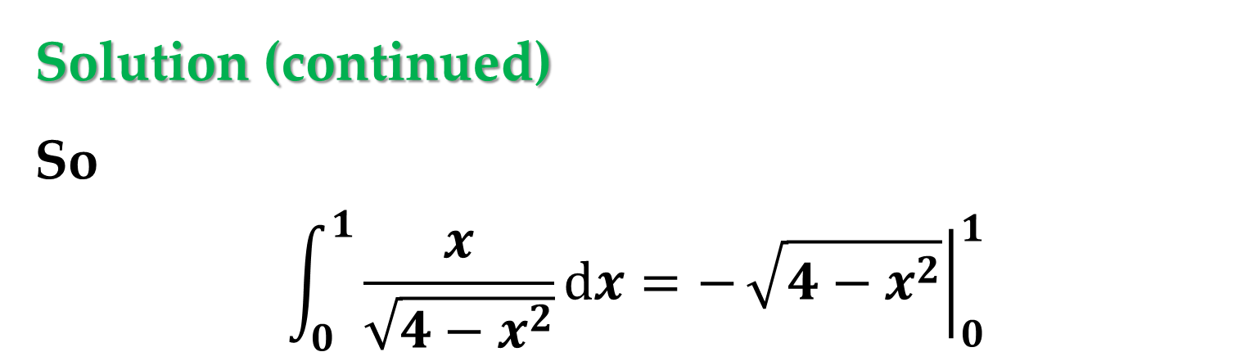

Solution (continued)
So
$$\int_{0}^{1}{\frac{x}{\sqrt{4−x^{2}}}dx}=−{\left.\sqrt{4−x^{2}}\right|}_{0}^{1}$$
$$\int_{0}^{1}{\frac{3}{\sqrt{4−x^{2}}}dx}=3\int_{0}^{1}{\frac{1}{\sqrt{{\left(2\right)}^{2}−{\left(x\right)}^{2}}}dx}$$
$$…=3{\left.arcsin \left(\frac{x}{2}\right)\right|}_{0}^{1}$$

Slide 15
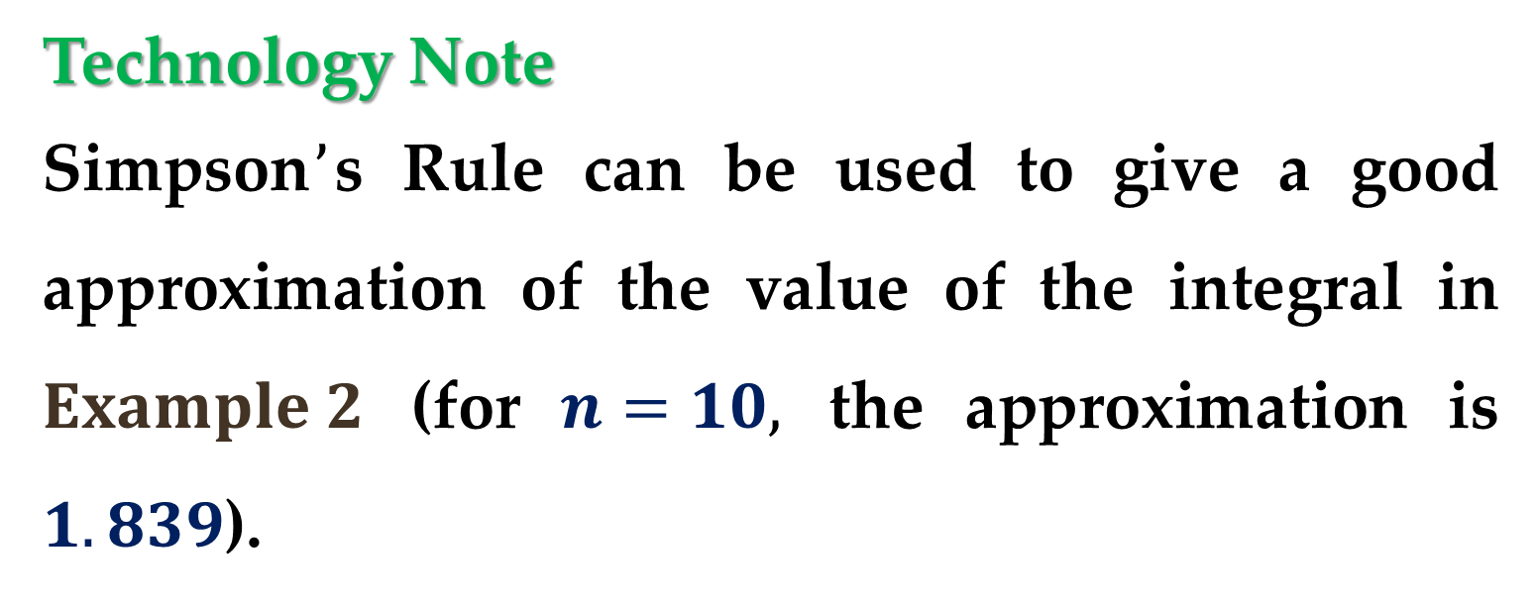
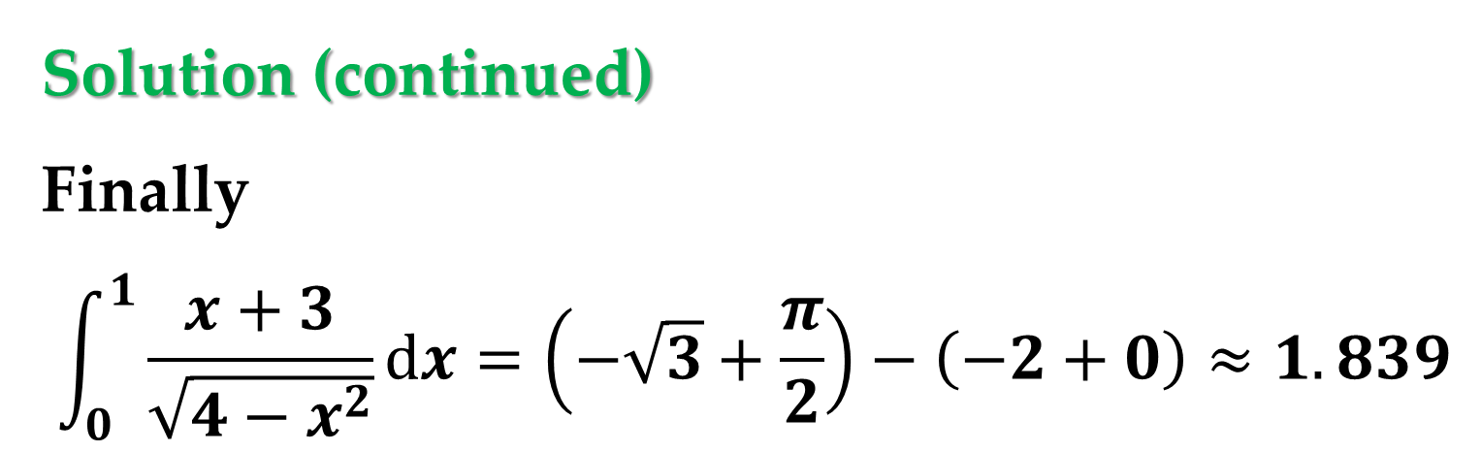
Solution (continued)
Finally
$$\int_{0}^{1}{\frac{x+3}{\sqrt{4−x^{2}}}dx}=\left(−\sqrt{3}+\frac{π}{2}\right)−\left(−2+0\right)≈1.839$$
Technology Note
Simpson$’$s Rule can be used to give a good approximation of the value of the integral in $Example 2$ (for $n=10,$ the approximation is $1.839$).

Slide 16
Technology Note (continued)
When using numerical integration, however, you should be aware that Simpson’s Rule does not always give good approximations.
This is especially true when one or both of the limits of integration are near a vertical asymptote.

Slide 17
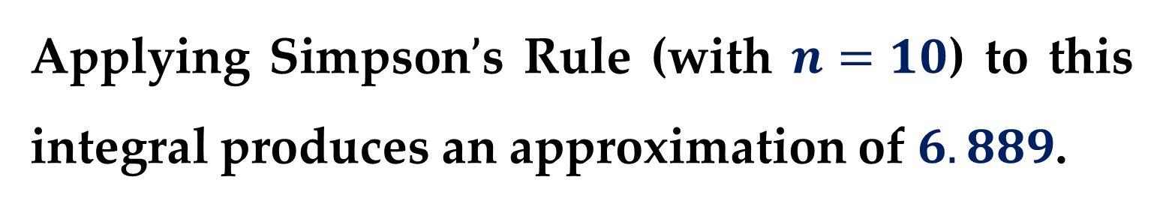
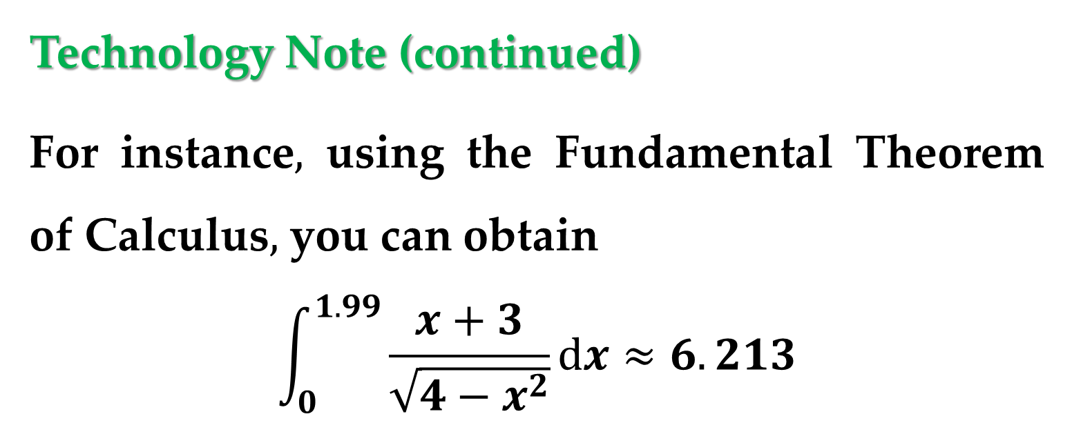
Technology Note (continued)
For instance$,$ using the Fundamental Theorem of Calculus$,$ you can obtain
$$\int_{0}^{1.99}{\frac{x+3}{\sqrt{4−x^{2}}}dx}≈6.213$$
Applying Simpson$’$s Rule (with $n=10$) to this integral produces an approximation of $6.889$.

Slide 18
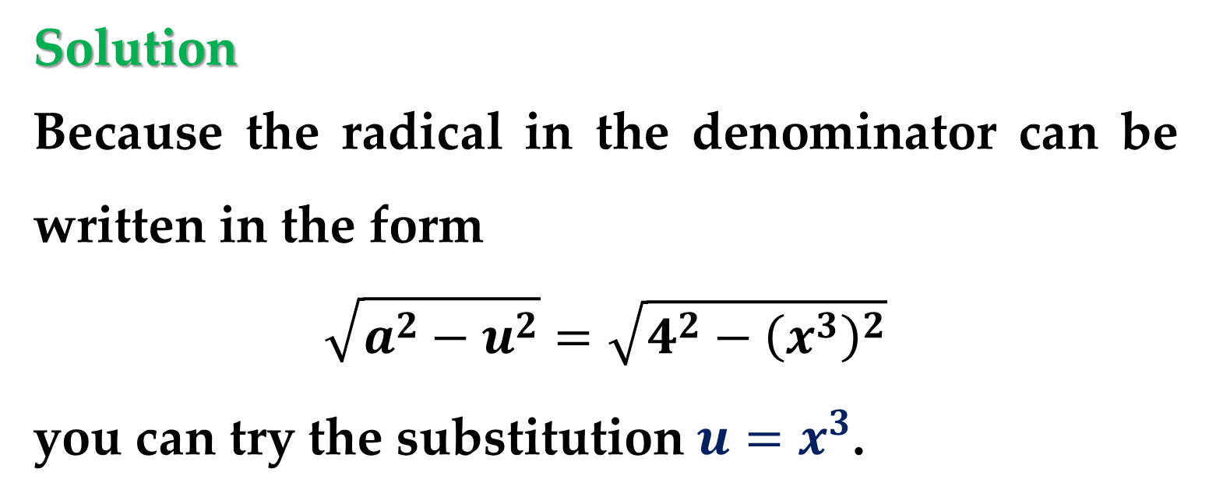
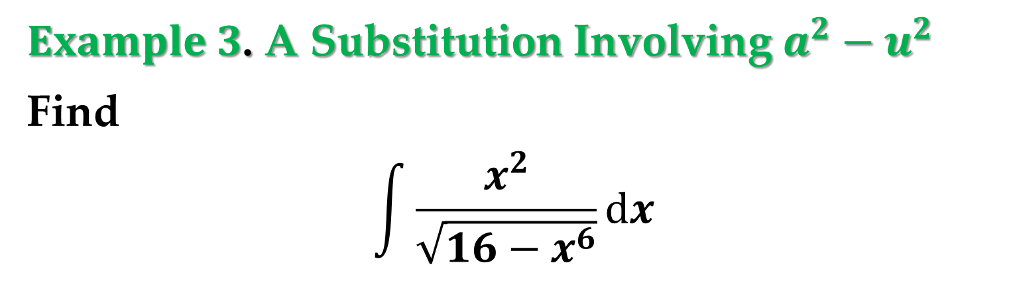
$Example 3$. A Substitution Involving $a^{2}−u^{2}$
Find
$$\int{\frac{x^{2}}{\sqrt{16−x^{6}}}dx}$$
Solution
Because the radical in the denominator can be written in the form
$$\sqrt{a^{2}−u^{2}}=\sqrt{4^{2}−{\left(x^{3}\right)}^{2}}$$
you can try the substitution $u=x^{3}$.

Slide 19
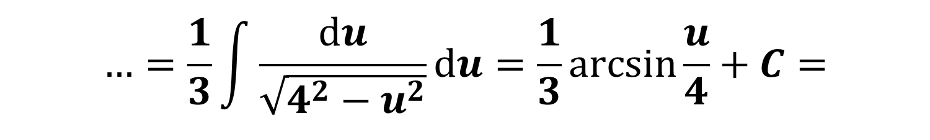
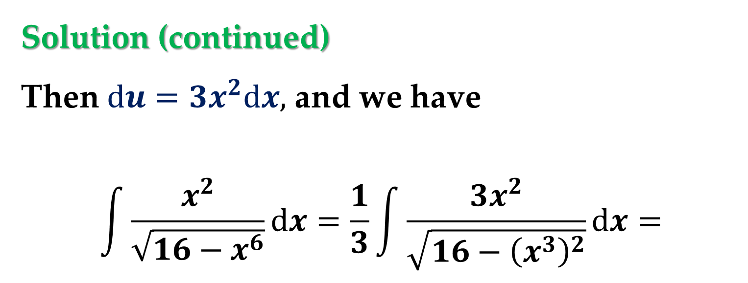

Solution (continued)
Then $du=3x^{2}dx,$ and we have
$$\int{\frac{x^{2}}{\sqrt{16−x^{6}}}dx}=\frac{1}{3}\int{\frac{3x^{2}}{\sqrt{16−{\left(x^{3}\right)}^{2}}}}dx=$$
$$…=\frac{1}{3}\int{\frac{du}{\sqrt{4^{2}−u^{2}}}du}=\frac{1}{3}arcsin\frac{u}{4}+C=$$
$$…=\frac{1}{3}arcsin\frac{x^{3}}{4}+C$$

Slide 20
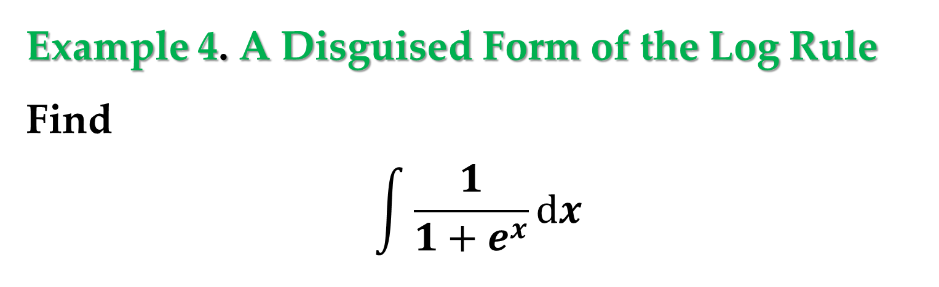
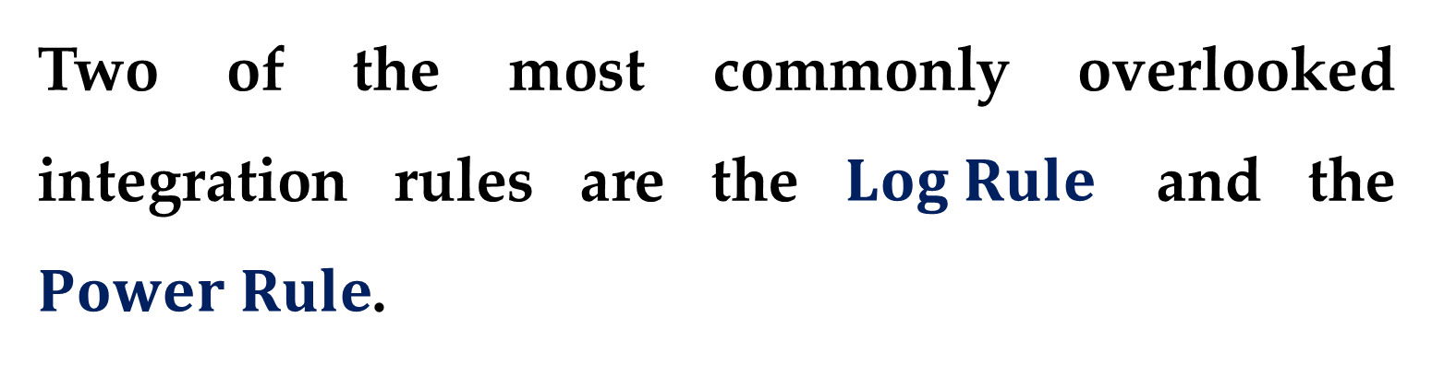
Two of the most commonly overlooked integration rules are the $Log Rule$ and the $Power Rule$.
Notice in the next two examples how these two integration rules can be disguised.
Example 4. A Disguised Form of the Log Rule
Find
$$\int{\frac{1}{1+e^{x}}dx}$$

Slide 21
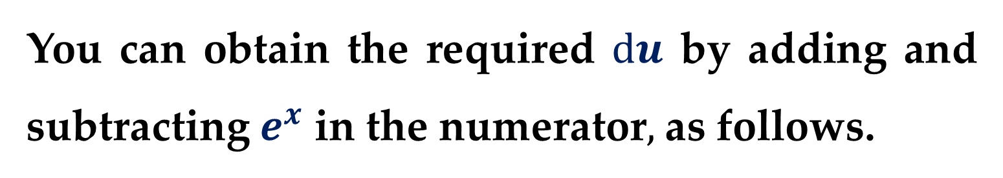
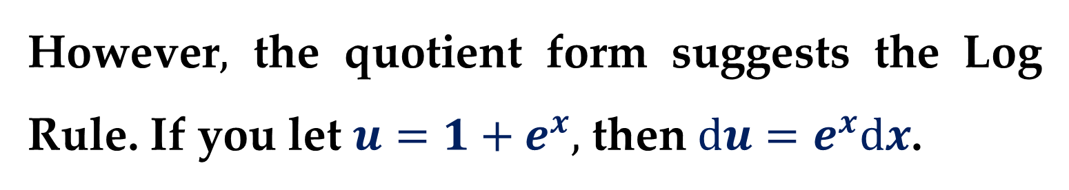
Solution
The integral does not appear to fit any of the basic rules.
However$,$ the quotient form suggests the Log Rule. If you let $u=1+e^{x},$ then $du=e^{x}dx$.
You can obtain the required $du$ by adding and subtracting $e^{x}$ in the numerator$,$ as follows.

Slide 22

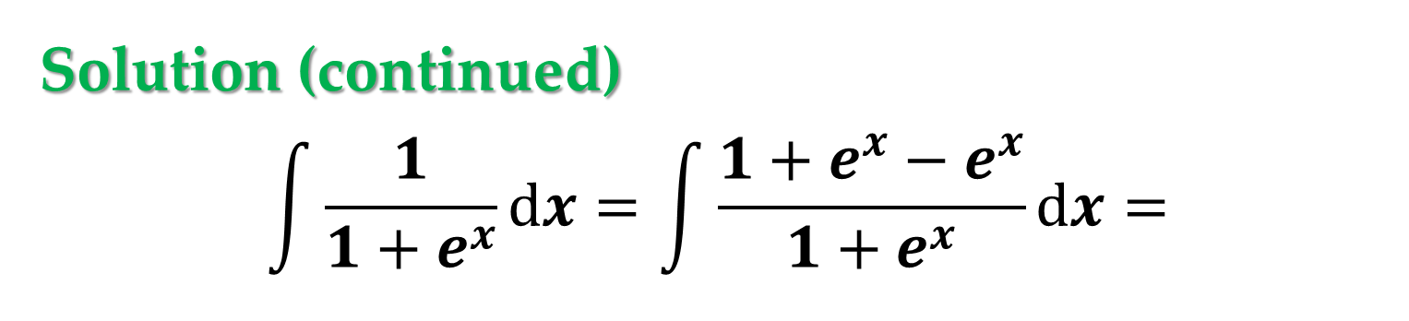

Solution (continued)
$$\int{\frac{1}{1+e^{x}}dx}=\int{\frac{1+e^{x}−e^{x}}{1+e^{x}}dx}=$$
$$…=\int{1dx}−\int{\frac{e^{x}}{1+e^{x}}dx}=$$
$$…=x−\ln\left|1+e^{x}\right|+C=$$
$$=x−\ln\left(1+e^{x}\right)+C$$

Slide 23
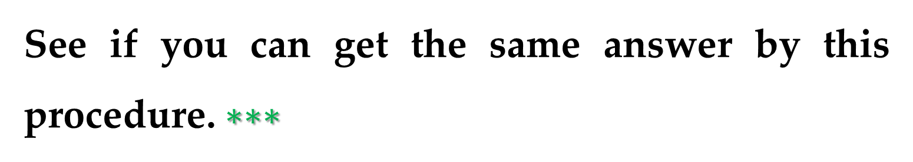
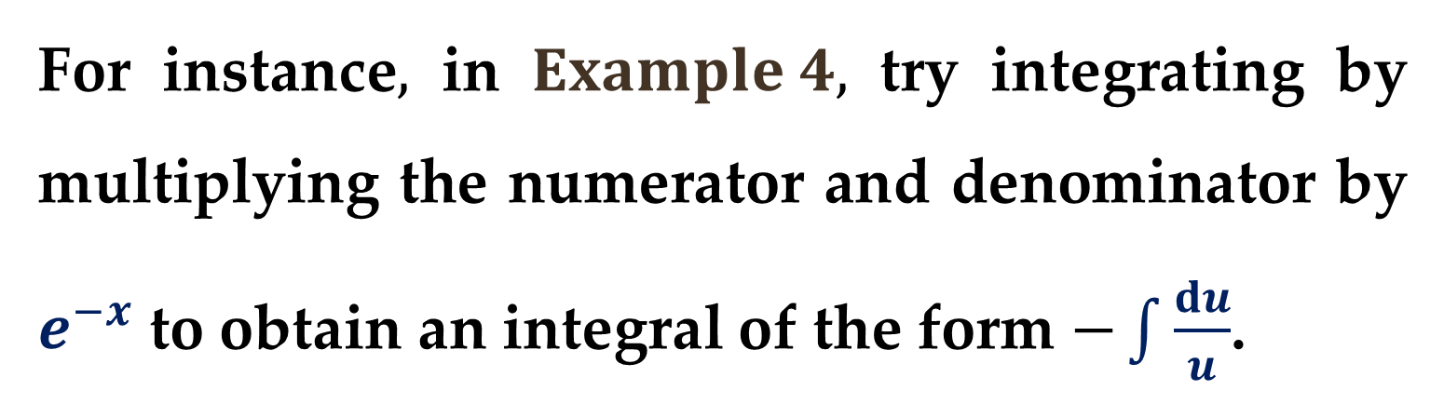
Note
There is usually more than one way to solve an integration problem.
For instance$,$ in $Example 4,$ try integrating by multiplying the numerator and denominator by $e^{−x}$ to obtain an integral of the form $−\int{\frac{du}{u}}$.
See if you can get the same answer by this procedure. $∗∗∗$

Slide 24
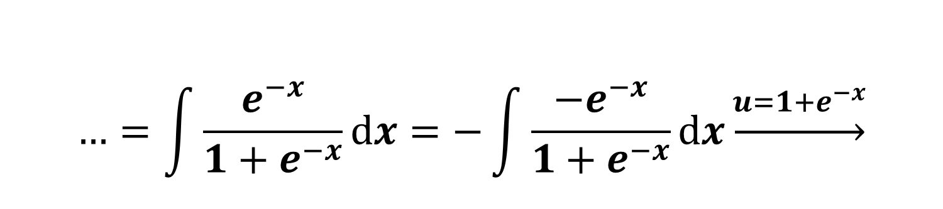
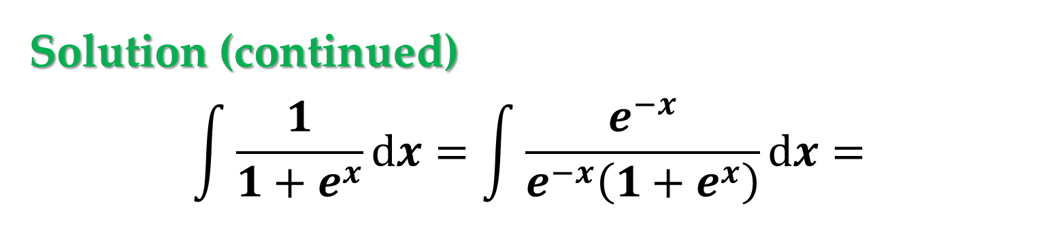
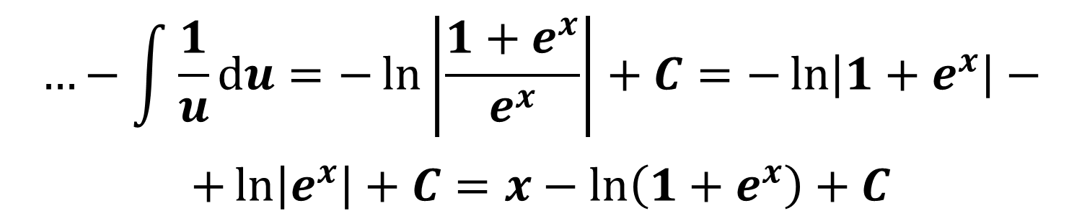
Solution (continued)
$$\int{\frac{1}{1+e^{x}}dx}=\int{\frac{e^{−x}}{e^{−x}\left(1+e^{x}\right)}dx}=$$
$$…=\int{\frac{e^{−x}}{{1+e}^{−x}}dx}=−\int{\frac{−e^{−x}}{{1+e}^{−x}}dx}\underset{→}{u=1+e^{−x}}$$
$$…−\int{\frac{1}{u}du}=−\ln\left|\frac{1+e^{x}}{e^{x}}\right|+C=−\ln\left|1+e^{x}\right|−$$
$$+\ln\left|e^{x}\right|+C=x−\ln\left(1+e^{x}\right)+C$$

Slide 25
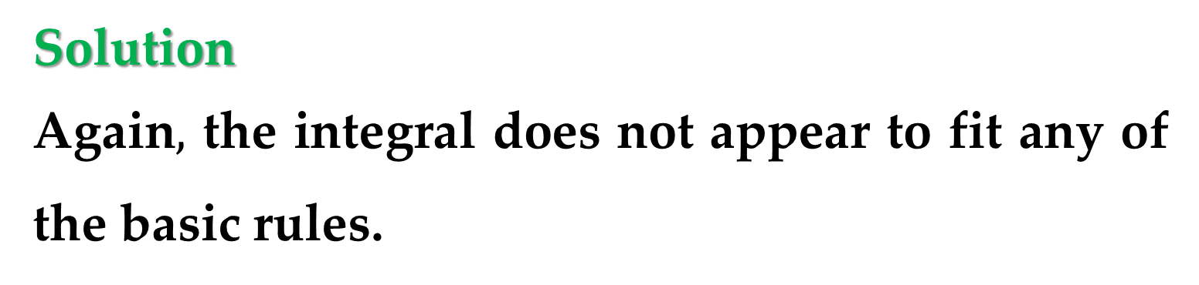
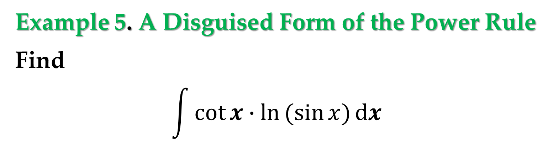
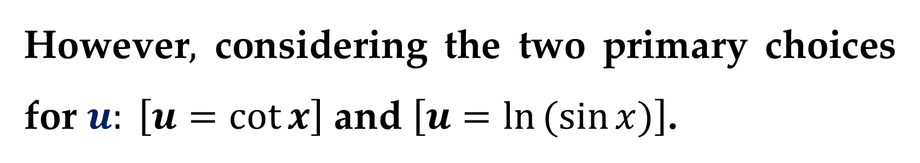
Example 5. A Disguised Form of the Power Rule
Find
$$\int{\cot{x}∙\ln{(sin{x)}}dx}$$
Solution
Again$,$ the integral does not appear to fit any of the basic rules.
However$,$ considering the two primary choices for $u: \left[u=\cot{x}\right]$ and $\left[u=\ln{(sin{x)}}\right]$.

Slide 26
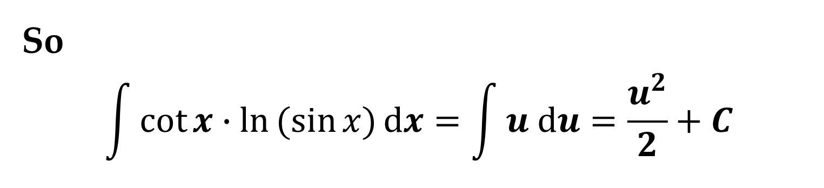
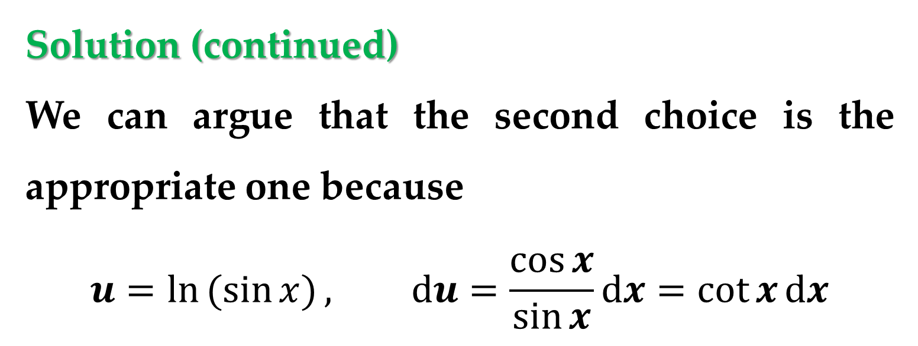
Solution (continued)
We can argue that the second choice is the appropriate one because
$$u=\ln{(sin{x)}}, du=\frac{\cos{x}}{\sin{x}}dx=\cot{x}dx$$
So
$$\int{\cot{x}∙\ln{(sin{x)}}dx}=\int{u du}=\frac{u^{2}}{2}+C$$

Slide 27
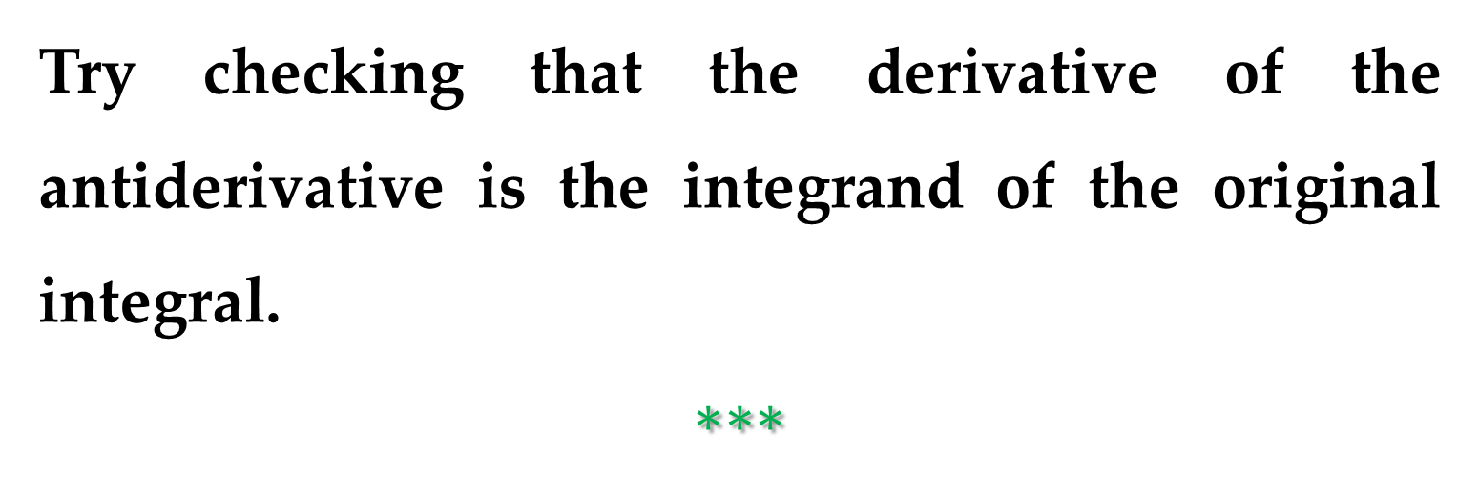
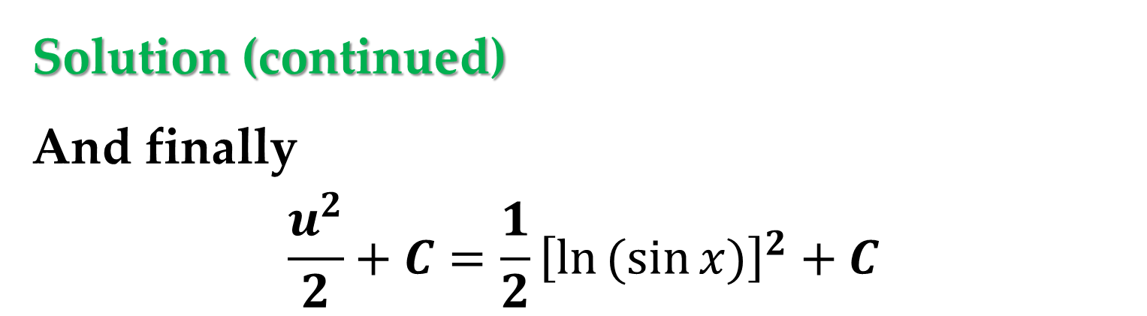
Solution (continued)
And finally
$$\frac{u^{2}}{2}+C=\frac{1}{2}{\left[\ln{(sin{x)}}\right]}^{2}+C$$
Try checking that the derivative of the antiderivative is the integrand of the original integral.
$$∗∗∗$$

Slide 28
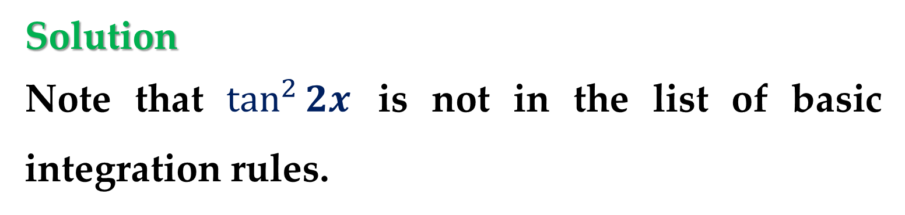
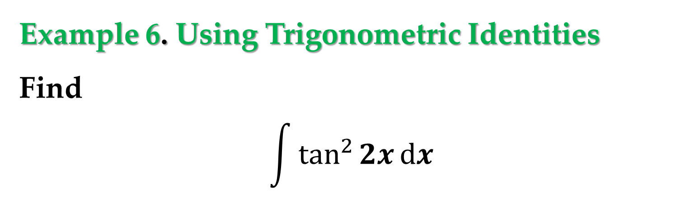
Trigonometric identities can often be used to fit integrals to one of the basic integration rules.
Example 6. Using Trigonometric Identities
Find
$$\int{\tan^{2}{2x}dx}$$
Solution
Note that $\tan^{2}{2x}$ is not in the list of basic integration rules.

Slide 29

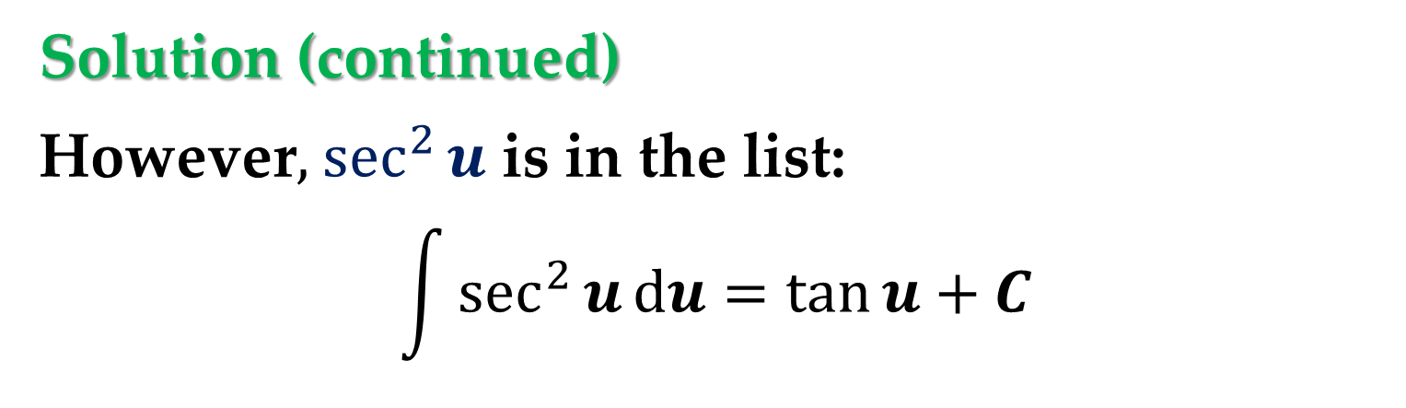
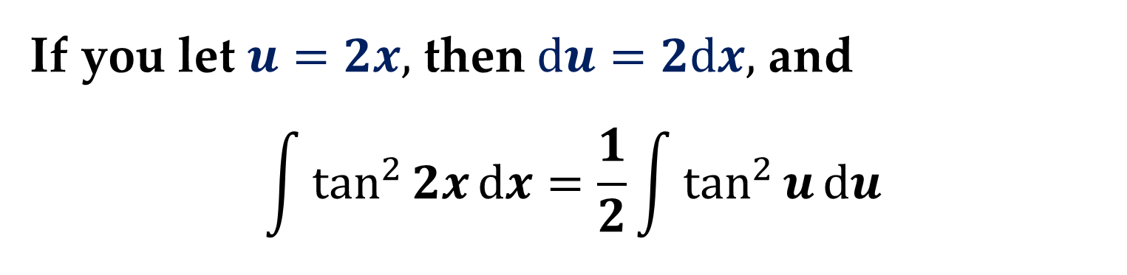
Solution (continued)
However$,$ $\sec^{2}{u}$ is in the list:
$$\int{\sec^{2}{u}du}=\tan{u}+C$$
This suggests the trigonometric identity
$$\tan^{2}{u}=\sec^{2}{u}−1$$
If you let $u=2x,$ then $du=2dx,$ and
$$\int{\tan^{2}{2x}dx}=\frac{1}{2}\int{\tan^{2}{u}}du$$

Slide 30

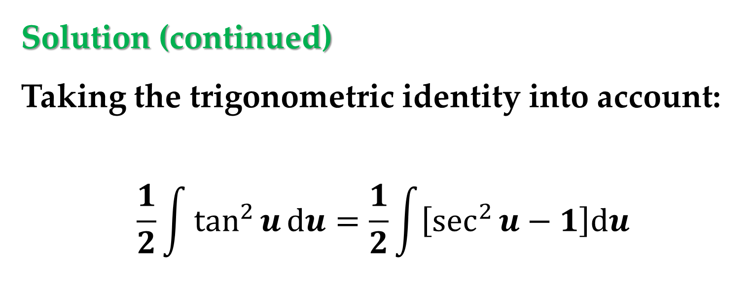

Solution (continued)
Taking the trigonometric identity into account:
$$\frac{1}{2}\int{\tan^{2}{u}}du=\frac{1}{2}\int{\left[\sec^{2}{u}−1\right]du}$$
$$…=\frac{1}{2}\int{\sec^{2}{u}du}−\frac{1}{2}\int{1du}$$
$$…=\frac{1}{2}\tan{u}−\frac{u}{2}+C=\frac{1}{2}\tan{2x}−x+C$$

Slide 31

This lecture concludes with a summary of the
common procedures for fitting integrands to the basic integration rules.

Slide 32


Technology Note
If you have access to a computer algebra system$,$ try using it to evaluate the integrals in this section.
Compare the forms of the antiderivatives given by the software with the forms obtained by hand.
Sometimes the forms will be the same$,$ but often they will differ.

Slide 33


A Comparison of Three Similar Integrals
Which$,$ if any$,$ of the following integrals can be evaluated using the basic integration rules?
$a)$ $\int{\frac{3}{\sqrt{1−x^{2}}}dx}$ $b)$ $\int{\frac{3x}{\sqrt{1−x^{2}}}dx}$ $c)$ $\int{\frac{3x^{2}}{\sqrt{1−x^{2}}}dx}$
For any that can be evaluated$,$ do so.
For any that can$’$t$,$ explain why.
$$∗∗∗$$

Slide 34


$$3\int{\frac{1}{\sqrt{1−x^{2}}}dx}=3\sin^{−1}{x}+C$$
$$\frac{3}{−2}\int{\frac{−2x}{\sqrt{1−x^{2}}}dx}=−\frac{3}{2}\int{\frac{d\left[1−x^{2}\right]}{\sqrt{1−x^{2}}}}→u=1−x^{2}$$
$$−\frac{3}{2}\int{\frac{du}{\sqrt{u}}}=−{3\left(1−x^{2}\right)}^{\frac{1}{2}}+C$$

Slide 35

$$3\int{\frac{x^{2}−1+1}{\sqrt{1−x^{2}}}dx}=3\int{\frac{−(1−x^{2})+1}{\sqrt{1−x^{2}}}dx}=$$
$$=−3\int{\frac{1−x^{2}}{\sqrt{1−x^{2}}}dx}+3\int{\frac{1}{\sqrt{1−x^{2}}}dx}=$$
$$=3\sin^{−1}{x}−3\int{\sqrt{1−x^{2}}dx} →x=\sin{u}$$
$$dx=\cos{u}du →$$

Slide 36

$$−3\int{\cos^{2}{u}du}=−3\int{\frac{1+\cos{2u}}{2}du}=$$
$$−3\int{\frac{1}{2}du}−\frac{3}{2}\int{\cos{2u} du}=\frac{−3}{2}\sin^{−1}{x}−\frac{3}{4}\sin{2\sin^{−1}{x}}$$
$$u=\sin^{−1}{x}$$

Slide 37
Thank you for attention

Slide 38
text
text
text

